Slide 1

Notes:
Set the scene: You are watching an episode of Selling Sunset season 10 - the battle of the agents. Nicole is the client and Nati and I are 2 agents that need to convince Nicole to choose us to sell her house. We hope you enjoy the episode!

Slide 2
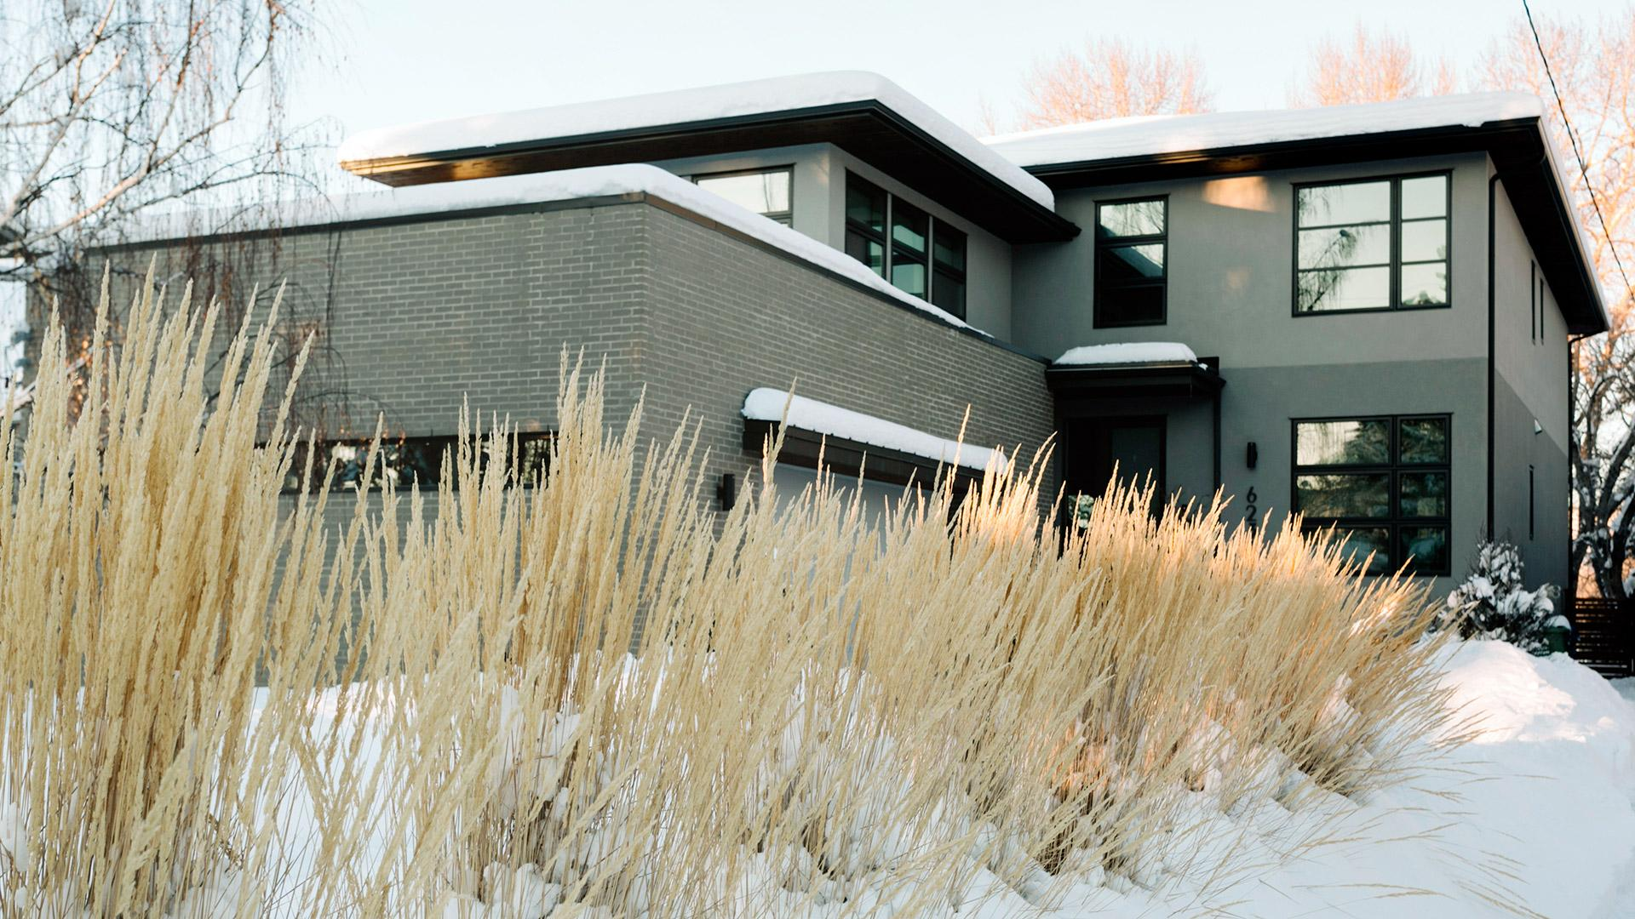
The client
Name: Dimples McBroke von Geizig
Occupation: Paints abstract chihuahuas for a living, got rich with selling NFTs
Reason for selling: To pay for bail after slapping both Chris Rock and Will Smith

Slide 3


The Client
Location
Expected Price
$1,000,000
Bellevue, King County
Dimples McBroke von Geizig
Description
Modernist architecture with red roof and blue and yellow walls. Originally built in 2011 as a fireworks store. Meticulously maintained front garden with stone pathway. Extra windows for natural light.

Slide 4
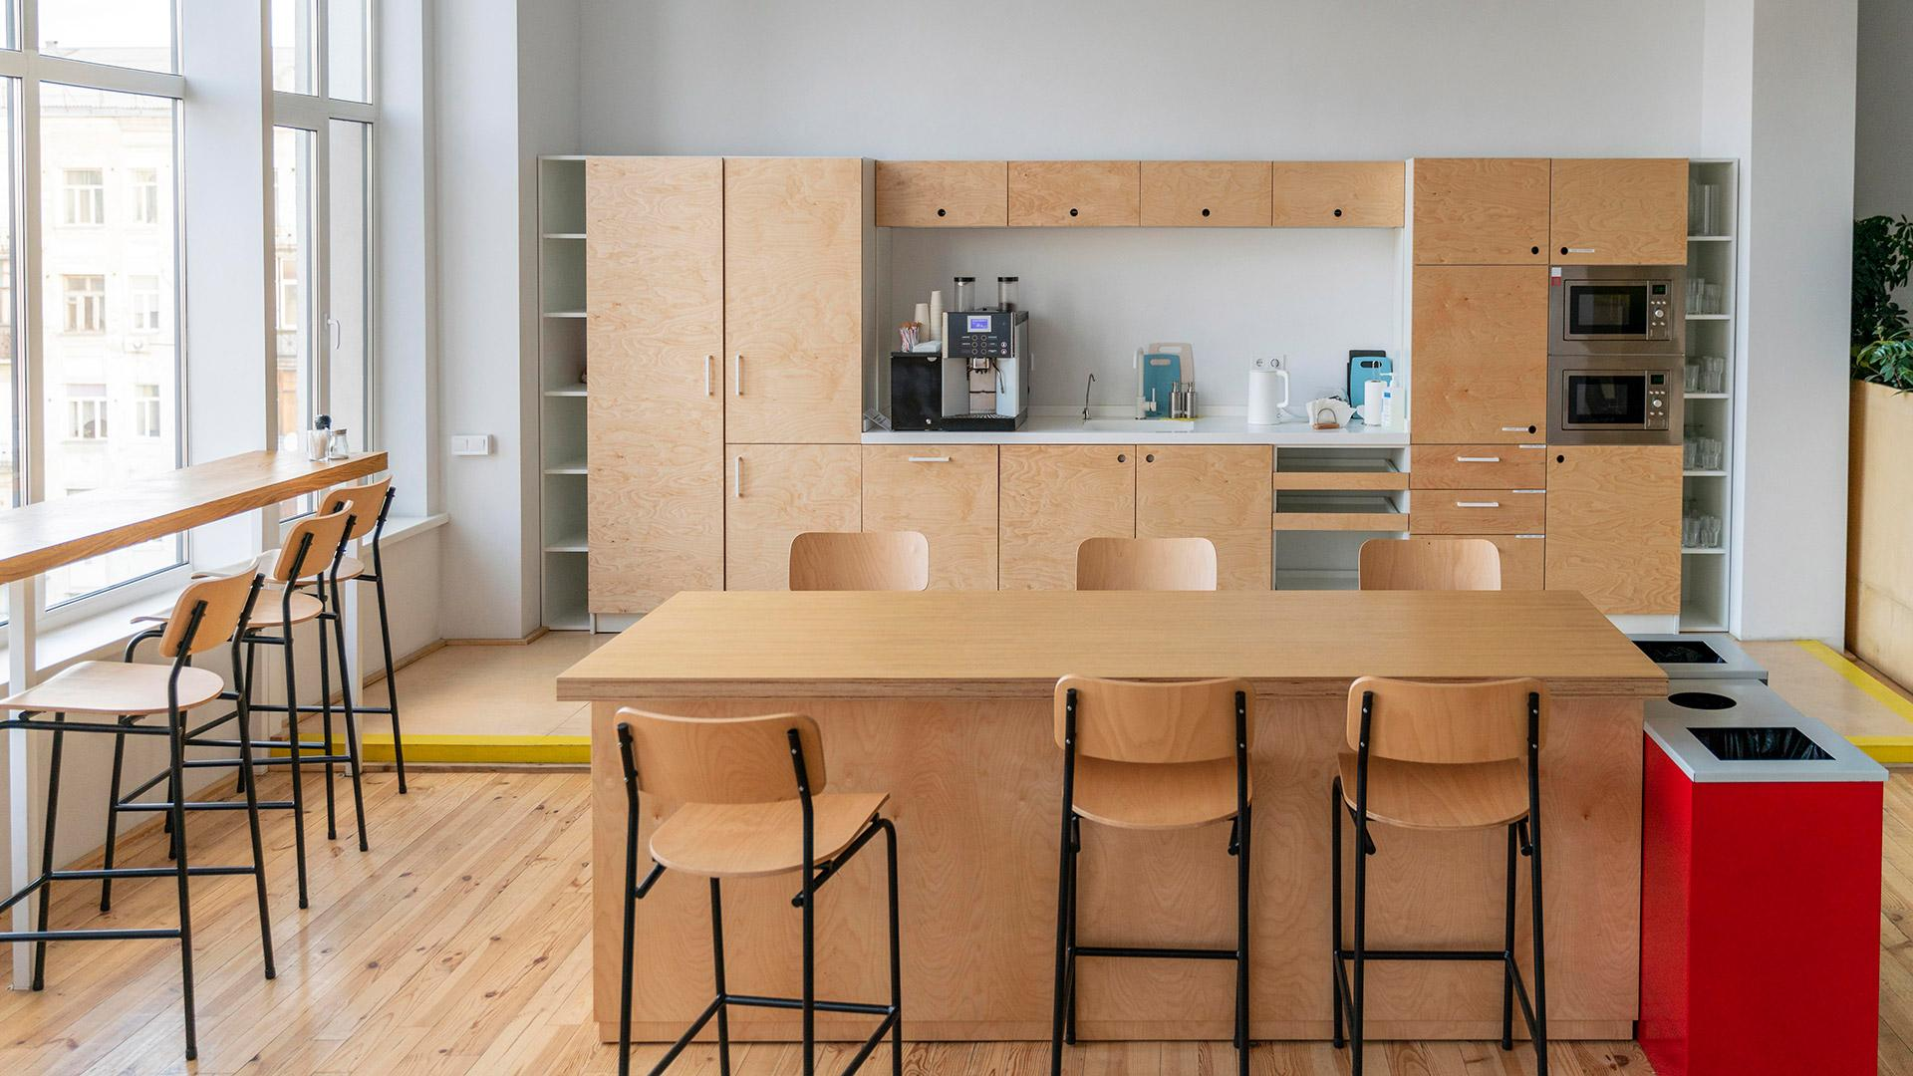
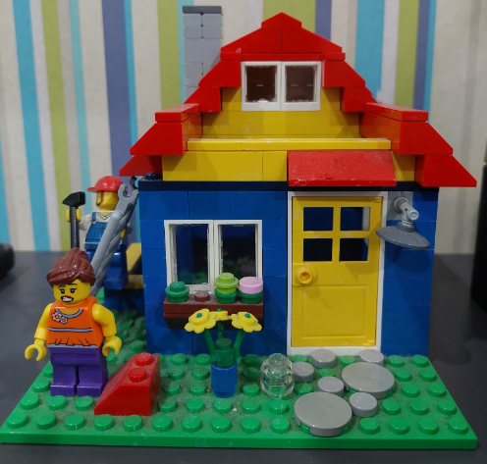
House blueprint
2015
3
2
850
1
Year of build
Bedrooms
Bathrooms
Square feet
Kitchen

Slide 5



Making Dream Homes Come True
Kirsty Gosling
Phone:
Email:
Unlock your future with the perfect home - trust me to open the door.
+88 321 45 67 88
kirsty@ironhack.com
Notes:
Hi Dimples McBroke von Geizig, thanks for coming to The Oppenheim Group, it’s great to have you on Selling Sunset!
My name is Kirsty Gosling and I want to help unlock your future with the perfect home - trust me to open the door
As and introduction:
I have 3 years of experience
Have had my broker's license for 2.5 years already
I’m specialised in the Seattle area
I have strong communication and negotiation skills
Keep up to date with market trends
And lastly, I am part of the elite social scene, so always know who’s buying and who’s selling before anyone else
Good for you to know is that we work with analysts at the Oppenheim group, that have developed models to help us get the perfect price for you

Slide 6
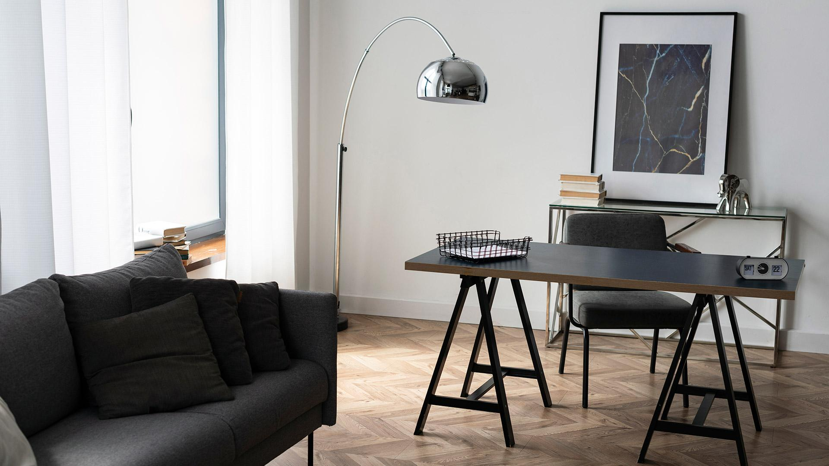
Key Driver of House Price
Bedroom
Bathroom
Floors
Condition
Notes:
The key drivers of house price that I focus on are number of bedrooms, number of bathrooms, number of floors and the condition

Slide 7
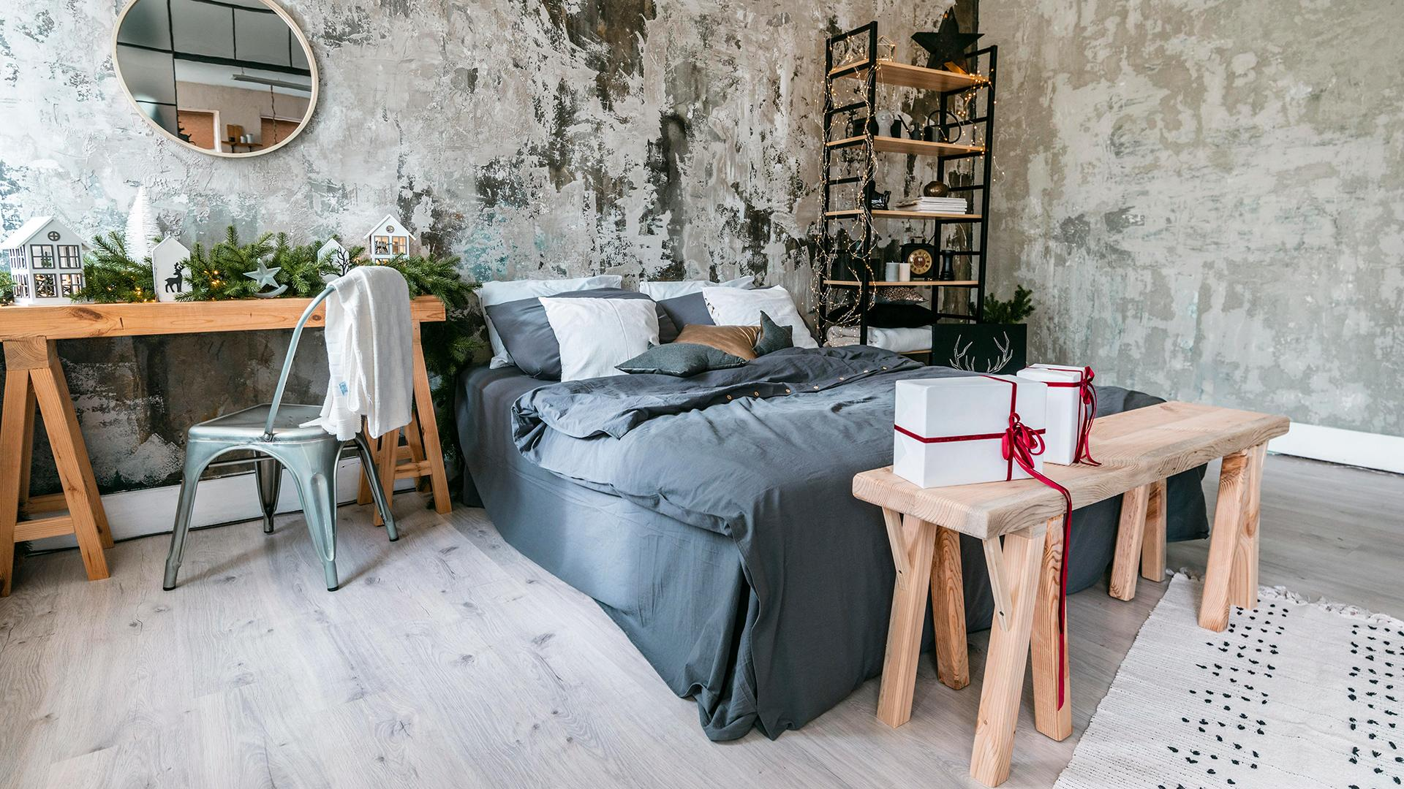

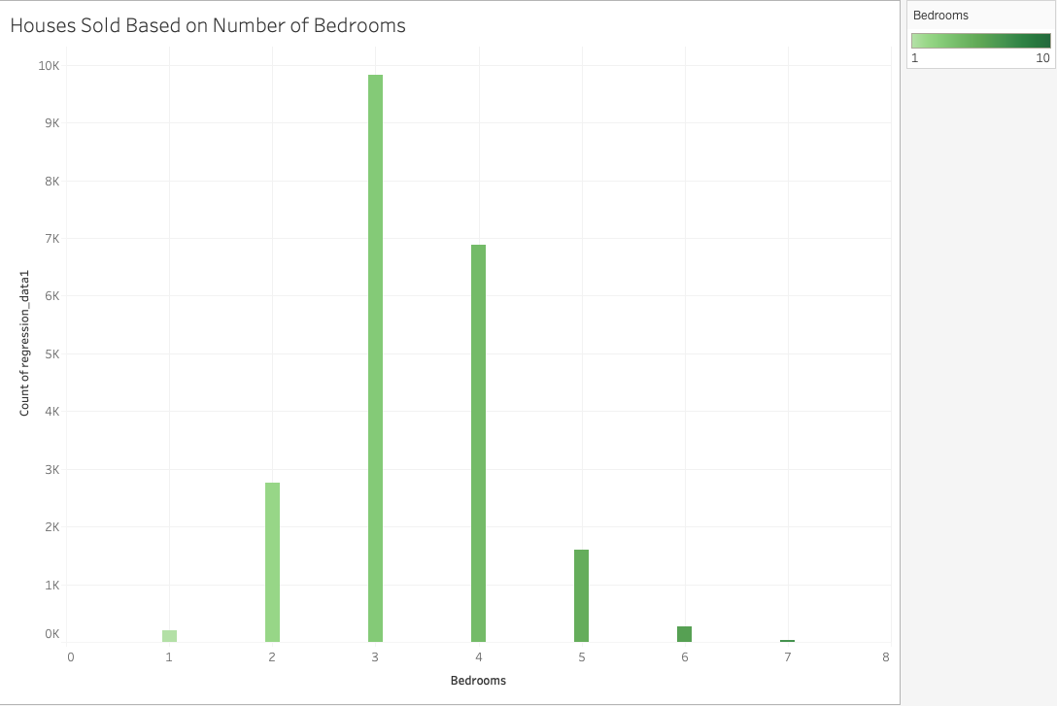
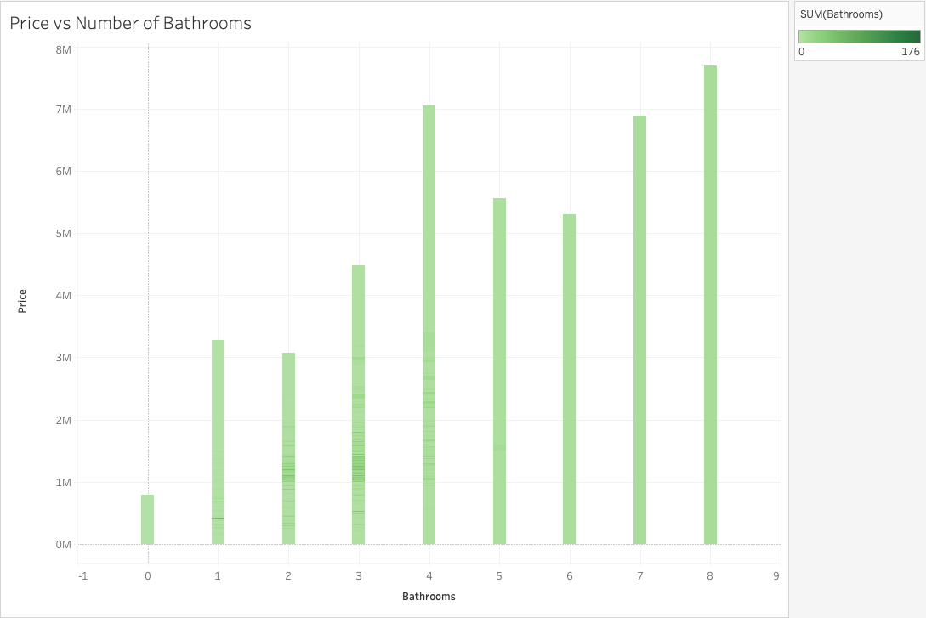
The number of bedrooms & bathrooms makes a difference
Notes:
Here we see that the ideal number of bedrooms is between 3 and 4, but even better that your house has 3!
Although your house has 2 bathrooms, which is on the lower side, we do see houses with 2 bathrooms selling for as much as 3 mil

Slide 8
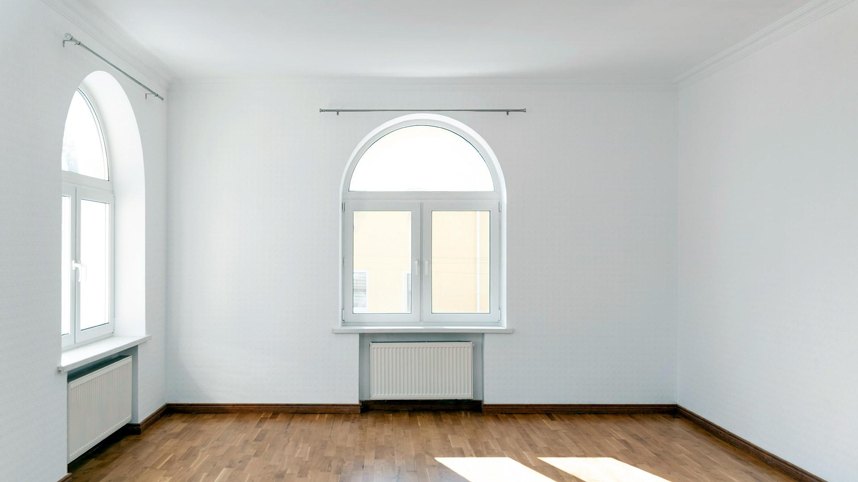
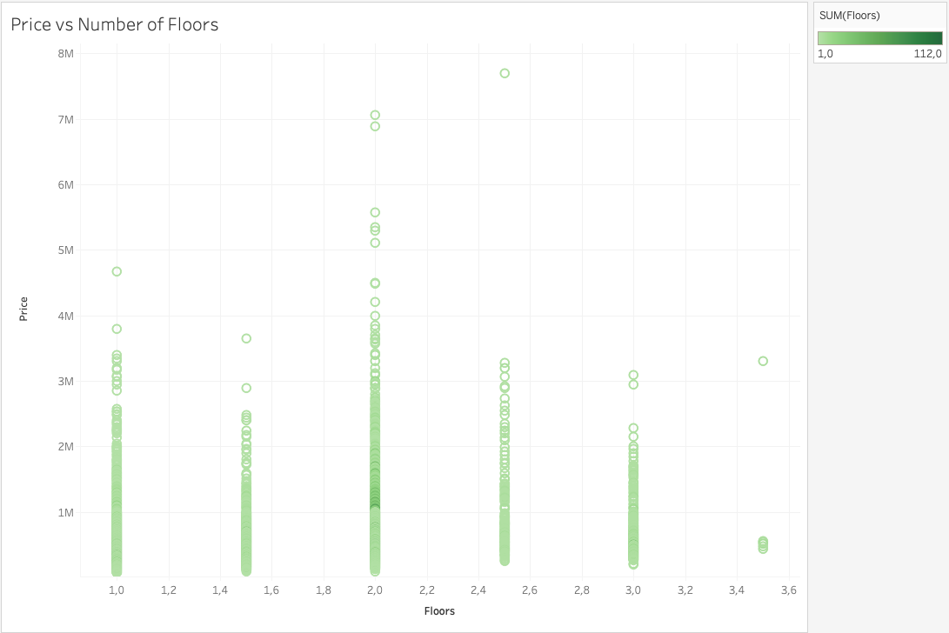
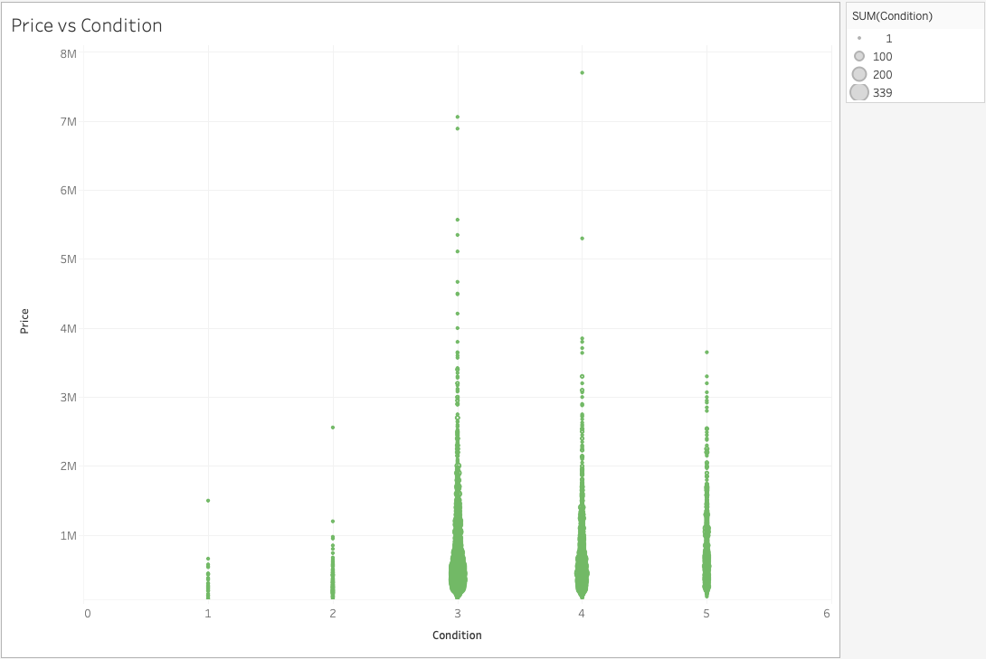
Number of Floors & Condition
Notes:
The number of floors and the impact it has on price is quite varied, where a lot of houses have 2, but the 1 floor that you have is not going to have that much of a negative impact on the price of your house
The condition of the house is really important when getting the price, a lot of houses have a condition of around 3, but yours is at 4, which is even better

Slide 9

What is the price of your house?
$1,500,000
$1,375,00
$1,625,000
Notes:
Based on all of these factors, I would say that your best price range is between 1.3 mil and 1.6, with an ideal asking price of 1.5 mil.
So Dimples McBroke, I hope that you can trust me with your house and keeping you out of jail
Linear Regression Result:
Based on the Mean Absolute Error (MAE) of $125k, we can estimate a range of approximately $1,375k to $1,625k around the predicted price of $1,500k. This range suggests that there is a typical deviation of around $125k from the actual price in either direction.
R2 = 0,71

Slide 10
Your Key to Home
Natnael Fekade
Phone:
Email:
Unlock the Door to Your Dream Home with Natnael, Your Trusted Real Estate Agent
+88 123 45 67 89
natnael@ironhack.com
Notes:
Thank you for giving me the opportunity to introduce myself to you
My name is Natnael and I have more than 10 years experience of selling houses and build up a large network with very famous and rich people
I am very good at my job and can promise that the End2end process from inspection to signing process will be very fast if you choose me as your real estate agent
Beside, I have access to a great database including thousands of verified entries about local properties
In the next slide, I'll show you how I typically approach this kind of real estate projects
Network
One of the top Agents around Hollywood and Seattle known for a loyal client base
Sold multiple houses for and to VIPs
Speed
Access to great data base including thousands of verified entries about local properties
End2end process from inspection to signing process is very fast
Expertise
Experience of more than 10 years in the real estate industry
Continuously researching about upcoming trends

Slide 11
Key Driver of House Price
Size
Location
Grade
Waterfront
Notes:
Before i dive in, I have to mention that I looked into the documents of your house and I'm really amazed from the features your house has
I was very surprised that an other real estate agent told you that the price of your house should only be around 1 million Dollar
After talking to our internal analysts i can assure you that we can definitely get an higher price for your house
Our analyst showed me the key drivers of the house price, which you can see on the slide, and told me that your house mostly covers the key drivers
In the following slides I will take a closer look at the key drivers and prove to you why i think you can get a higher price

Slide 12

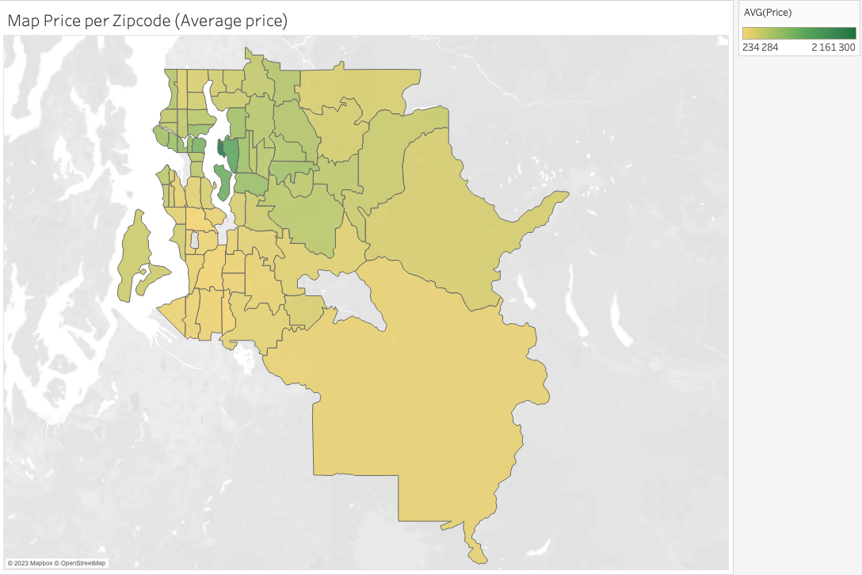
Location of Your Property
Bellevue
In this area, higher prices can be achieved.
Notes:
As you can see in the picture Bellevue is one of the most expensive areas in King County, followed by parts of Seattle, Redmond and Kirkland
Your house is actually located in Bellevue which is why we can demand a higher price for it
You can see that the price of the other houses in different part of the map is on average lower

Slide 13

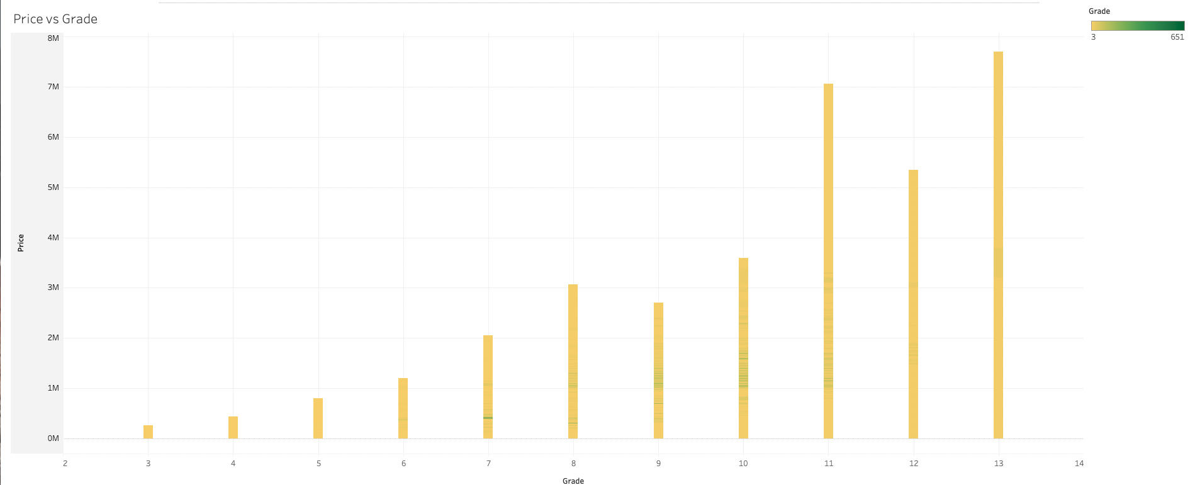

An excellent grade and a waterfront is beneficial
Notes:
Looking into your documents i figured out that your house has really good grade
In the picture you can see that the better graded houses have on average a higher price, so a good grade of the house influences heavily the price of a property
Besides I´m was very happy to see that you have a waterfront
As you can see in the graphics a house with a waterfront is on average $ 1 Million Dollars more expensive than a house without a waterfront
I know the area where your house is located at very well and the potential buyer is going to love the waterfront and has the possibility to do for example fishing, water ski or swimming

Slide 14
What is the price of your house?
$1,250,000
$1,180,000
$1,320,000
Notes:
Taking all things into consideration and including them in our analysis we recommend to sell the house for 1.25 million Dollars, which is 250k more than your initial offer
I can guarantee you that we keep the price within the range of +/- 70k Dollars
My Colleague Kirsty used the Linear Regression and showed you a higher price, but she didn't mention that the accuracy of her model is low
I played around with a lot of different models and decided to go with the RandomForestRegressor Model which includes a very accurate prediction
I can promise that i will continuously be on the look out for buyer and try to push the price more to the upper end to maybe get 1.3 Million Dollars for the house
If you go with me you have a high certainty what to expect and can be sure that you house get sold quickly
Random Forest Regressor:
Based on the Mean Absolute Error (MAE) of $70k, we can estimate a range of approximately $1,180k to $1,320k around the predicted price of $1,250k. This range suggests that there is a typical deviation of around $70k from the actual price in either direction.
R2 = 0,87

Slide 15

Going with Nati because he clearly knows his stuff
Client’s Decision

